Slide 1
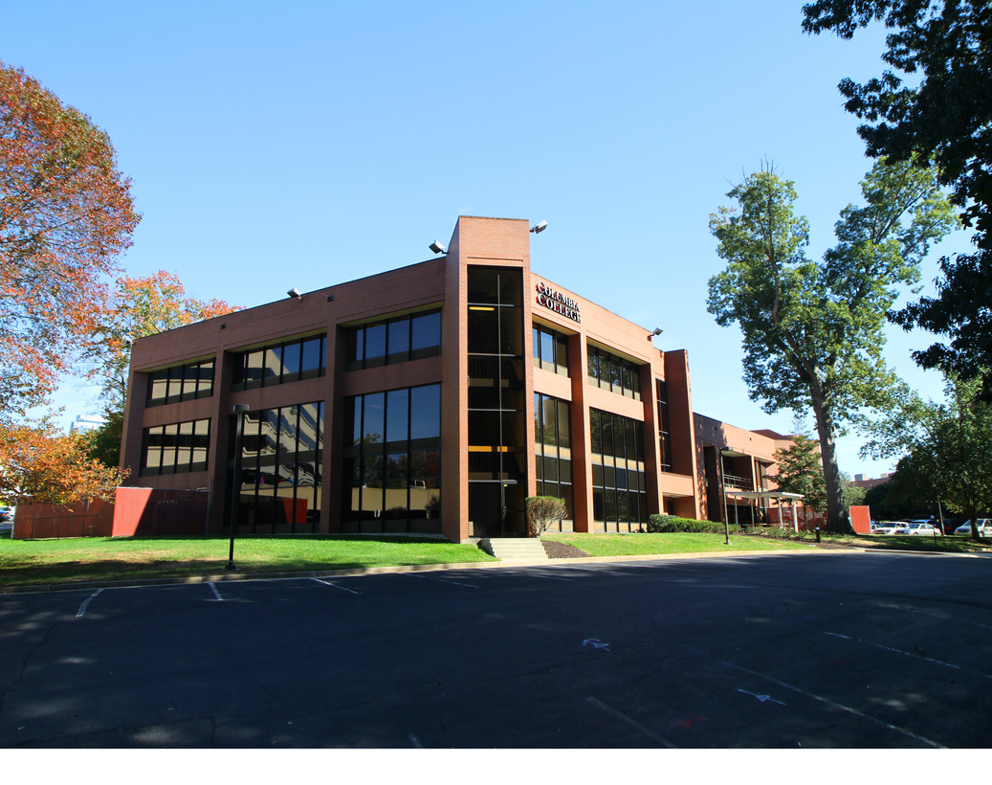

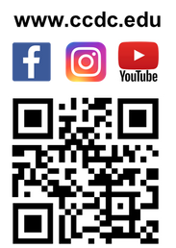









[ STUDENTS FIRST ]
WELCOME TO COLUMBIA COLLEGE
The mission of English as a Second Language Program at Columbia College is to prepare the students to function effectively in academic classes where English is the language of instruction. In doing so, we also seek students to have meaningful learning experiences by providing rich environment with American culture and the academic atmosphere that could be meaningful impact for their academic work and the personal journey of life.
ESL
COLUMBIA COLLEGE
LANGUAGE CENTER
ACCREDITATION
Contact Us
The Columbia College English as a Second Language Program (CCESLP) is accredited by the
Commission on English Language Program Accreditation for the period August 2023 through
August 2027 and agrees to uphold the CEA Standards for English Language Programs and
Institutions.
CEA is recognized by the U.S. Secretary of Education as a nationally recognized
accrediting agency for English language programs and institutions in the U.S.
(703) 206-0508
www.ccdc.edu
info@ccdc.edu
[ ACCREDITED BY ]
WHY COLUMBIA COLLEGE?
  Certified School for i-20 issuance :F1students
  Established in 1999
  Placement Test : 6 levels
  Affordable Tuition
  Location: Washington Metropolitan Area
  Diversity : International students from 50 countries
@ccdcedu
Columbia College Virginia
@ccdcedu
COLUMBIA COLLEGE LANGUAGE CENTER
8620 Westwood Center Dr, Vienna, VA 22182

Slide 2



ESL
COLUMBIA COLLEGE
PROGRAM DESCRIPTION : 6 LEVELS
GRAB
YOUR FUTURE
LANGUAGE CENTER
English as a Second Language (ESL) applicants are administered a nationally recognized exam called CaMLA as a placement test. In addition, in-house speaking and writing exams are conducted as part of placement test.
This program is designed to provide comprehensive English skills classes, including grammar, listening, speaking, reading, and writing. The goal is for students to acquire fluency in English so that they can seek further opportunities in the United States without communication difficulties.
Journey with Columbia College.
Columbia College offers educational opportunities for students from all over the world. We have representatives with various language and cultural backgrounds to welcome international students. Through various events, you will enjoy campus life.
BEGINNER I -101 / BEGINNER II -102
2023-24 ESL ADMISSIONS CALENDAR
The beginners level introduces students to both the spoken and written forms of the English language using modern methods. It provides basic grammar instruction through interactive activities in the classroom.
Session | Start Date
 | 08/21/2023
 | 09/25/2023
 | 10/30/2023
 | 12/04/2023
 | 01/15/2024
 | 02/20/2024
 | 03/25/2024
 | 04/29/2024
 | 06/03/2024
 | 07/08/2024
 | 08/19/2024
 | 09/23/2024
FIELD TRIPS
2023
Fall
A
National Cherry Blossoms Festivals, Smithsonian Museums, Folklife and many more
Fall
B
INTERMEDIATE I - 201 / INTERMEDIATE II - 202
Winter
A
Winter
B
The intermediate level continues to provide students with ample opportunities to improve their English abilities in speaking and listening. Additionally, it introduces students to the basics of academic reading and writing, along with grammar.
TOEFL
Test of English as a Foreign Language
2024
Spring I
A
Spring I
B
TOEFL preparation course in Columbia College is designed to obtain a target TOEFL score within 10 weeks.
Spring II
A
Spring II
B
Summer
A
ADVANCED I - 301 / ADVANCED II - 302
Summer
B
TO PASS RELEVANT COURSEWORK WITH A SUCCESSFUL GRADE, STUDENTS ARE REQUIRED TO
Fall
A
The advanced level strives to enhance students' English abilities in speaking, listening, reading, and writing. Students are introduced to reading academic research and advanced writing techniques. This level effectively prepares students for entry into any college in the United States.
Fall
B
1. Maintain satisfactory attendance (80%);
2. Participate in the class work including presentation
and assignment
3. Obtain passing grades (C or better).
TUITION and Fees INFORMATION
( PER10-WEEK ) Application fee $100
Programs | Tuition | Hours per week
Intensive ESL | $1,840 | 20Hrs.
Part-Time ESL | $990 | 10Hrs.
TOEFL Prep | $1,235 | 9Hrs.

